Slide 1


Day – 24 : Conditional Functions
Course created by Satish Dhawale | www.skillcourse.in

Slide 2
Conditional functions return results based on specified conditions.
Function | Description | Example | Result
CASE | Returns value based on condition | SELECT CASE WHEN salary > 50000 THEN 'High' ELSE 'Low' END FROM employees; | High/Low based on salary
COALESCE() | Returns the first non-NULL value | SELECT COALESCE(NULL, 'Default', 'Value'); | Default

Slide 3
1. CASE Function – Categorizing Based on Conditions
We will categorize products into price ranges:
Expensive if the price is greater than or equal to 50,000.
01
Moderate if the price is between 10,000 and 49,999.
02
Affordable if the price is less than 10,000.
03

Slide 4
Assignment : CASE with AND & OR Operators – Stock Status
We will classify products based on quantity available:
In Stock if quantity is 10 or more.
Limited Stock if quantity is between 5 and 9.
Out of Stock Soon if quantity is less than 5.

Slide 5
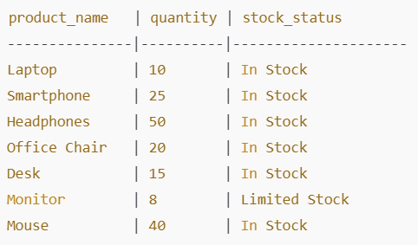
Output Should be like this

Slide 6
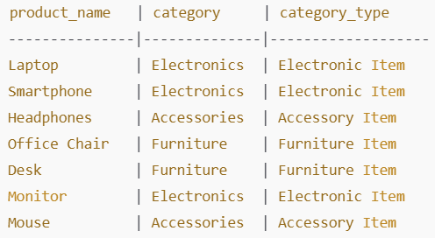
CASE with LIKE Operator – Category Classification
Check if the category name contains "Electronics Item" or "Furniture Item“ or “Accessory Item using LIKE
Output Should be like this

